Slide 1


Slide 3







Match each number to a description.
Each number can be matched with more than one description.
$\frac{\text{1}}{\text{3}}$
$\frac{\text{9}}{\text{2}}$
$\frac{\text{8}}{\text{3}}$
$\frac{\text{4}}{\text{7}}$
$\frac{\text{2}}{\text{5}}$
$\text{2}$
$\text{7}$
Non-unit fraction
Unit fraction
Improper fraction
Proper fraction
Less than 1
Mixed number
Greater than 1
Incorrectly written

Slide 4
Match each number to a description.
Each number can be matched with more than one description.
$\frac{\text{1}}{\text{3}}$
$\frac{\text{9}}{\text{2}}$
$\frac{\text{8}}{\text{3}}$
$\frac{\text{4}}{\text{7}}$
$\frac{\text{2}}{\text{5}}$
$\text{2}$
$\text{7}$
Non-unit fraction
Unit fraction
Improper fraction
Proper fraction
Less than 1
Mixed number
Greater than 1
Incorrectly written

Slide 5
Match each number to a description.
Each number can be matched with more than one description.
$\frac{\text{1}}{\text{3}}$
$\frac{\text{9}}{\text{2}}$
$\frac{\text{8}}{\text{3}}$
$\frac{\text{4}}{\text{7}}$
$\frac{\text{2}}{\text{5}}$
$\text{2}$
$\text{7}$
Non-unit fraction
Unit fraction
Improper fraction
Proper fraction
Less than 1
Mixed number
Greater than 1
Incorrectly written

Slide 6




Match each number to a description.
Each number can be matched with more than one description.
$\frac{\text{2}}{\text{3}}$
$\frac{\text{1}}{\text{3}}$
$\frac{\text{9}}{\text{2}}$
$\frac{\text{8}}{\text{3}}$
$\frac{\text{4}}{\text{7}}$
$\frac{\text{2}}{\text{5}}$
$\text{4}$
$\text{2}$
$\text{7}$
Non-unit fraction
Unit fraction
Improper fraction
Proper fraction
Less than 1
Mixed number
Greater than 1
Incorrectly written

Slide 7
Match each number to a description.
Each number can be matched with more than one description.
$\frac{\text{1}}{\text{3}}$
$\frac{\text{9}}{\text{2}}$
$\frac{\text{8}}{\text{3}}$
$\frac{\text{4}}{\text{7}}$
$\frac{\text{2}}{\text{5}}$
$\text{2}$
$\text{7}$
Non-unit fraction
Unit fraction
Improper fraction
Proper fraction
Less than 1
Mixed number
Greater than 1
Incorrectly written

Slide 8
Match each number to a description.
Each number can be matched with more than one description.
$\frac{\text{1}}{\text{3}}$
$\frac{\text{9}}{\text{2}}$
$\frac{\text{8}}{\text{3}}$
$\frac{\text{4}}{\text{7}}$
$\frac{\text{2}}{\text{5}}$
$\text{2}$
$\text{7}$
Non-unit fraction
Unit fraction
Improper fraction
Proper fraction
Less than 1
Mixed number
Greater than 1
Incorrectly written

Slide 10



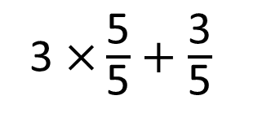
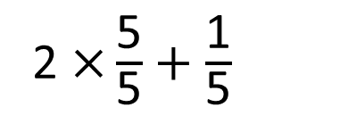



2 $\frac{\text{1}}{\text{5}}$ $+$ 3 $\frac{\text{3}}{\text{5}}$ $=$
$$\frac{\text{29}}{\text{5}}$$
or 5 $\frac{\text{4}}{\text{5}}$
I’m going to convert both mixed numbers to improper fractions first
2 $\frac{\text{1}}{\text{5}}$ $=$ $\frac{\text{1}\text{1}}{\text{5}}$
3 $\frac{\text{3}}{\text{5}}$ $=$ $\frac{\text{18}}{\text{5}}$
3 $\text{×}\frac{\text{5}}{\text{5}}$ $+$ $\frac{\text{3}}{\text{5}}$
2 $\text{×}\frac{\text{5}}{\text{5}}$ $+$ $\frac{\text{1}}{\text{5}}$

Slide 11


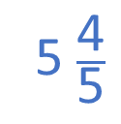


2 $\frac{\text{1}}{\text{5}}$ $+$ 3 $\frac{\text{3}}{\text{5}}$ $=$
5 $\frac{\text{4}}{\text{5}}$
I’m going to add my whole numbers and fractions separately.
2 $+$ 3 $=$ 5
$\frac{\text{1}}{\text{5}}$ $+$ $\frac{\text{3}}{\text{5}}$ $=$ $\frac{\text{4}}{\text{5}}$

Slide 12



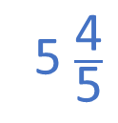






I’m going to convert them both to improper fractions first
2 $\frac{\text{1}}{\text{5}}$ $=$ $\frac{\text{1}\text{1}}{\text{5}}$
3 $\frac{\text{3}}{\text{5}}$ $=$ $\frac{\text{18}}{\text{5}}$
2 $\frac{\text{1}}{\text{5}}$ $+$ 3 $\frac{\text{3}}{\text{5}}$ $=$
$$\frac{\text{29}}{\text{5}}$$
or 5 $\frac{\text{4}}{\text{5}}$
I’m going to add my whole numbers and fractions separately.
$\frac{\text{1}}{\text{5}}$ $+$ $\frac{\text{3}}{\text{5}}$ $=$ $\frac{\text{4}}{\text{5}}$
2 $+$ 3 $=$ 5
2 $\frac{\text{1}}{\text{5}}$ $+$ 3 $\frac{\text{3}}{\text{5}}$ $=$
5 $\frac{\text{4}}{\text{5}}$
Whose method do you prefer? Why?
Have a think

Slide 13
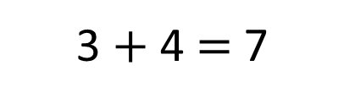

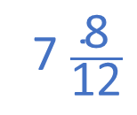


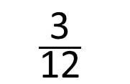
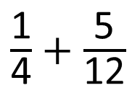
3 $\frac{\text{1}}{\text{4}}$ $+$ 4 $\frac{\text{5}}{\text{12}}$ $=$
7 $\frac{\text{8}}{\text{12}}$
$\frac{\text{1}}{\text{4}}$ $+$ $\frac{\text{5}}{\text{12}}$
$×$ 3
$$\frac{\text{3}}{\text{12}}$$
3 $+$ 4 $=$ 7
$\frac{\text{3}}{\text{12}}$ $+$ $\frac{\text{5}}{\text{12}}$ $=$ $\frac{\text{8}}{\text{12}}$

Slide 14
Have a go at questions
1 - 4 on the worksheet

Slide 15


Have a think
$$\frac{\text{1}}{\text{15}}$$
2 m
$$\frac{\text{4}}{\text{5}}$$
In this rectangle each longer side is longer than each shorter side.
1 m
What is the perimeter of the rectangle?

Slide 16












$$\frac{\text{1}}{\text{15}}$$
2 m
$$\frac{\text{1}}{\text{15}}$$
$$\frac{\text{4}}{\text{5}}$$
$$\frac{\text{13}}{\text{15}}$$
$$\frac{\text{12}}{\text{15}}$$
2
+
1
=
3
m
$$\frac{\text{13}}{\text{15}}$$
3
m
$$\frac{\text{1}}{\text{15}}$$
2 m
$$\frac{\text{4}}{\text{5}}$$
In this rectangle each longer side is longer than each shorter side.
1 m
What is the perimeter of the rectangle?
$$\frac{\text{1}}{\text{15}}$$
$$\frac{\text{1}}{\text{15}}$$
$$\frac{\text{13}}{\text{15}}$$
$$\frac{\text{28}}{\text{15}}$$
2
+
$$\frac{\text{13}}{\text{15}}$$
$$\frac{\text{13}}{\text{15}}$$
10
2
+
3
+
3
=
11
m

Slide 17
Have a go at questions
5 - 6 on the worksheet

Slide 18

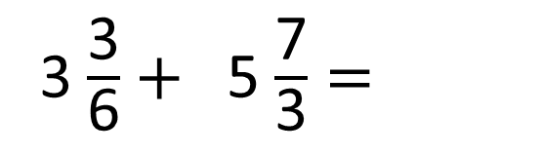
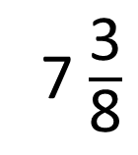
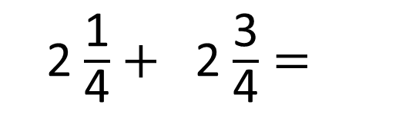
2
1
1
2
2 $\frac{\text{1}}{\text{4}}+$ 2 $\frac{\text{3}}{\text{4}}=$
3
7 $\frac{\text{3}}{\text{8}}$
6
1
5
4
2
4
3 $\frac{\text{3}}{\text{6}}+$ 5 $\frac{\text{7}}{\text{3}}=$
$\frac{\text{7}}{\text{6}} =$
6
Have a think

Slide 19
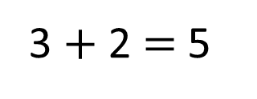
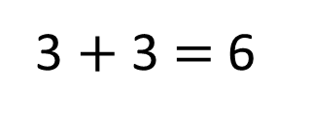

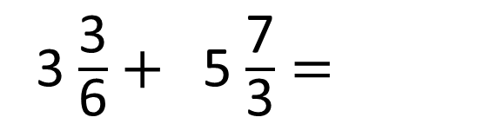

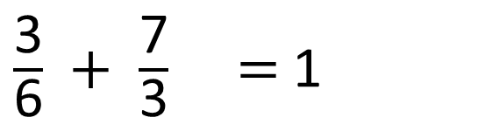
4
1
36
3 $\frac{\text{3}}{\text{6}}+$ 5 $\frac{\text{7}}{\text{3}}=$
3
$\frac{\text{7}}{\text{6}} =$
2
6
3 $+$ 2 $=$ 5
3 $+$ 3 $=$ 6
4
1
$\frac{\text{3}}{\text{6}} +$ $\frac{\text{7}}{\text{3}} =$ 1
$\frac{\text{2}}{\text{6}}$

Slide 20
Have a go at questions
7 - 8 on the worksheet

